Slide 1
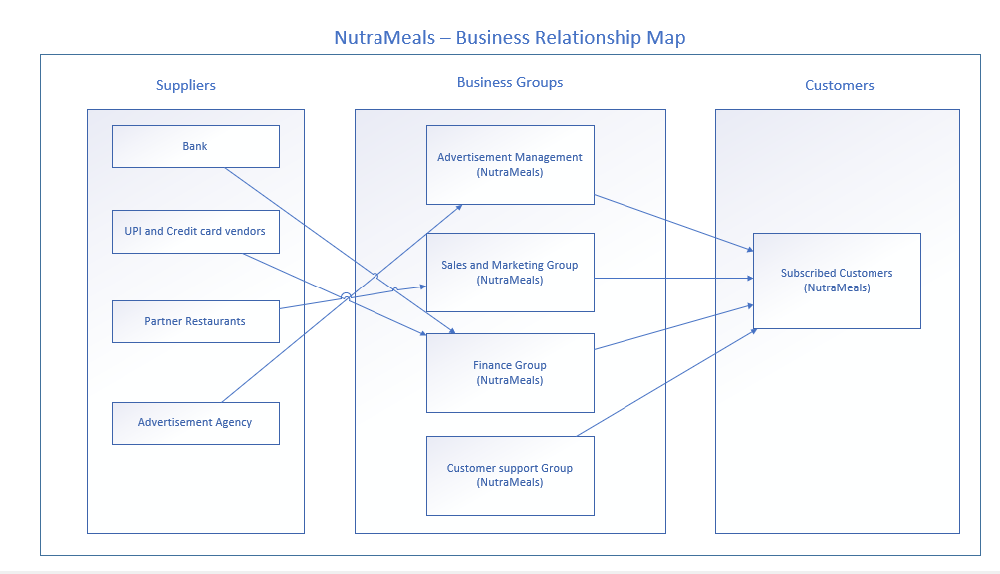

Slide 2
User Roles by Business Group
External Users (Customers)
Subscribed Customers
Internal Users
Business Group | User Roles | Team Member Name (Bus. Group Proxy)
Advertisement Management | Advertisement Representative Food popularity trend Analyst
Sales and Marketing Group | Area Sales Manager Sales broker
Finance Group | Accountant
Customer Support Group | Customer care representative Supervisor

